Slide 1
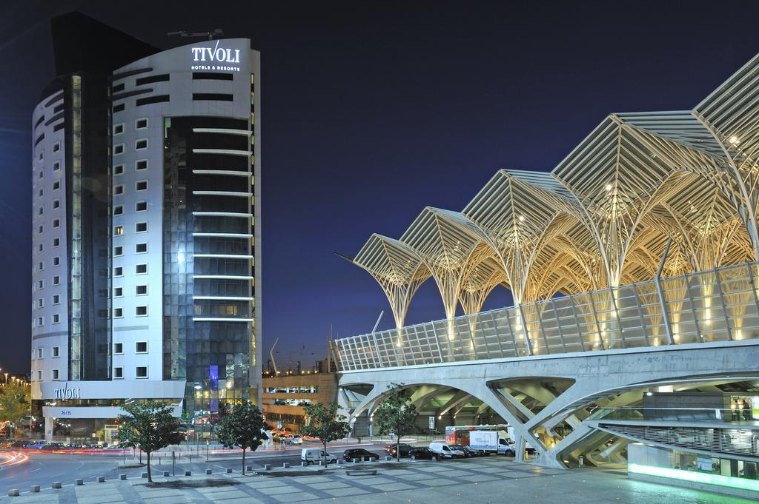
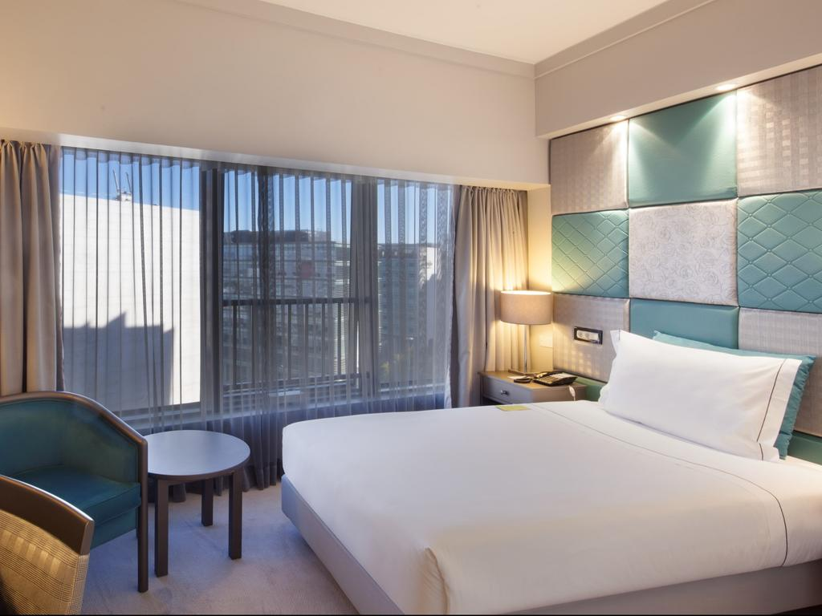
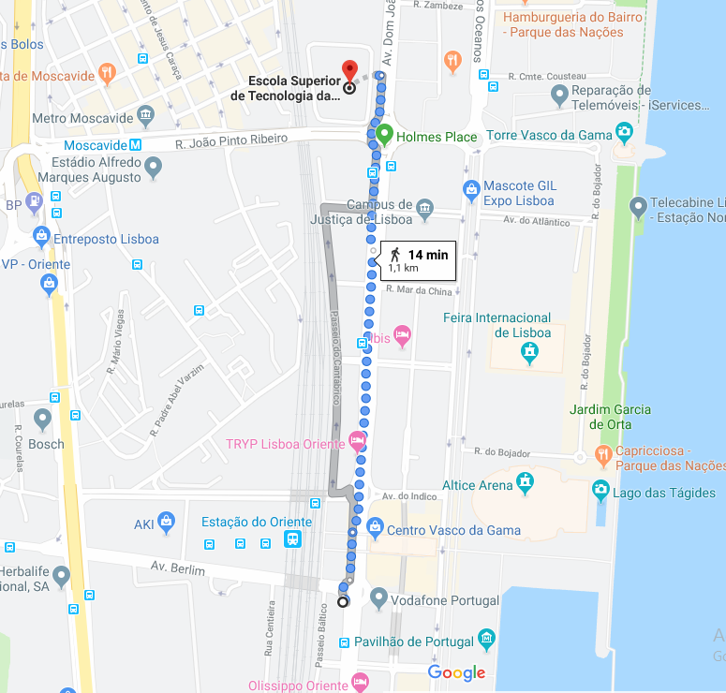
HOTEL TIVOLI
ORIENTE * * * *
https://www.tivolihotels.com/pt/tivoli-oriente
Tivoli Oriente Lisboa Hotel provides Contemporary hotel within Lisbon’s iconic Parque das Nações, overlooking the Tagus River. It features an indoor pool with a hot tub, relaxation facilities and a refurbished fitness centre. Renovated and soundproofed rooms at Tivoli Oriente hotel offer catchy interior decorations, most with designer furnishings and stunning views over Lisbon, the Tagus River or the business centre avenue. They all include satellite TV channels and en suite bathrooms with bathtub or shower. Guests can enjoy enticing cocktails at the Sky Bar which provides panoramic views over Lisbon and the Tagus River. Popular landmarks nearby the hotel Tivoli Oriente include the adjacent Vasco da Gama Shopping Centre and Estação do Oriente Station. Lisbon International Airport is just a 5-minute drive away and 3 metro stops (10 minutes) away.

